Slide 1
Guide for the Traineeship agreement

Slide 2


1
Fill out the information about all three parties
Fill out information about yourself and the receiving institution.
Fill in your name and the academic year of your mobility
Fill out the official email of the company. We do not accept domain as @gmail.com, @Hotmail.com etc.

Slide 3
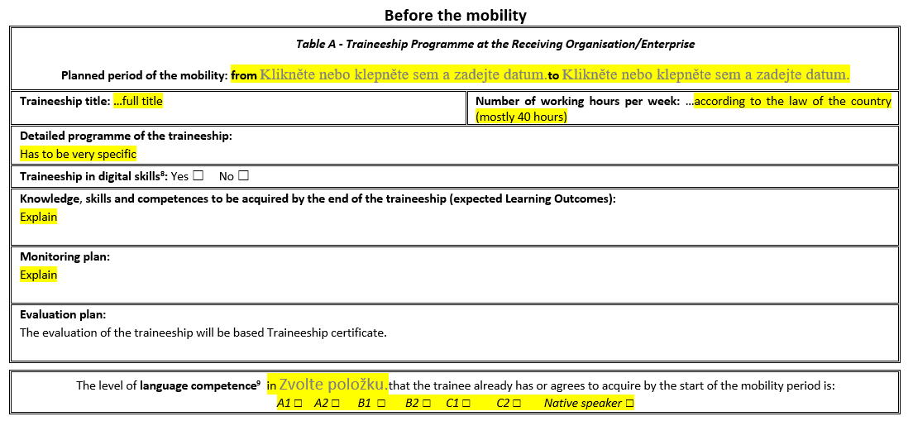
2
Fill out the information about the internship
The lenght of the internship must be more than 60 days (Erasmus) or 30 days (Bilateral agreements)
The internship can not start/end on weekend.
Indicate the language you will use for communication during your internship (mostly English).
Indicate your current competence in this language.

Slide 4
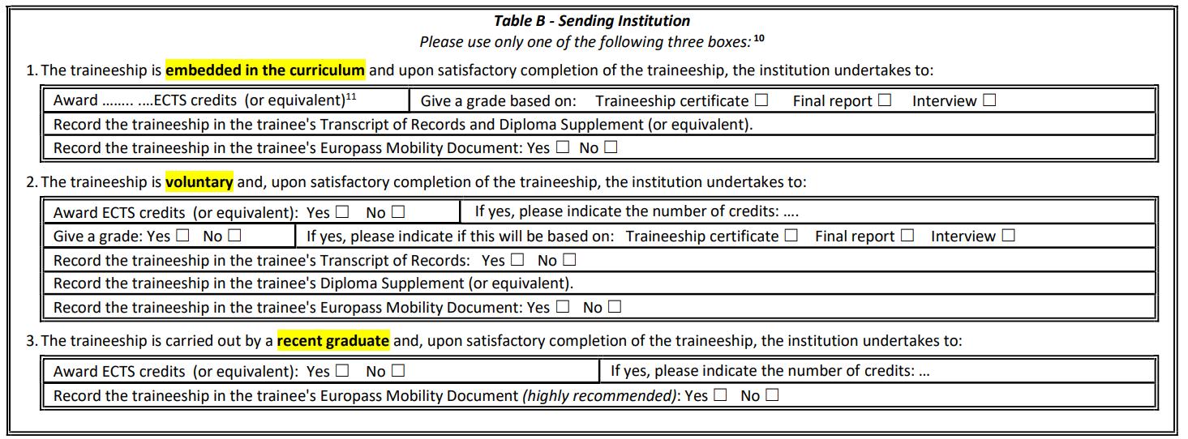
3
Fill out the information about the internship
You will select one part of the table B and fill it out. You can not fill out multiple sections!
You will fill out the first table if you wish to have the credits from this mobility recognized as “Practical Training” from your study plan.
You will fill out the second table if you do not wish to have your credits recognized as “Practical Training“.
If you have already graduated from FBE MENDELU, please fill out the third table.

Slide 5
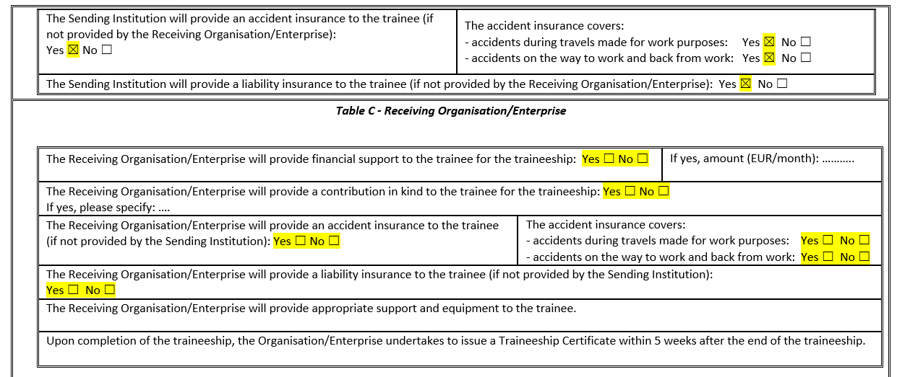
4
Fill out the information about insurance
For every item under the "Sending Institution", the option “Yes” will be selected.
For the "Receiving Institution", please fill out these columns according to your agreement with the foreign institution. We strongly encourage you to complete this section, as the Traineeship Agreement can serve as official proof of your prior arrangement.

Slide 6
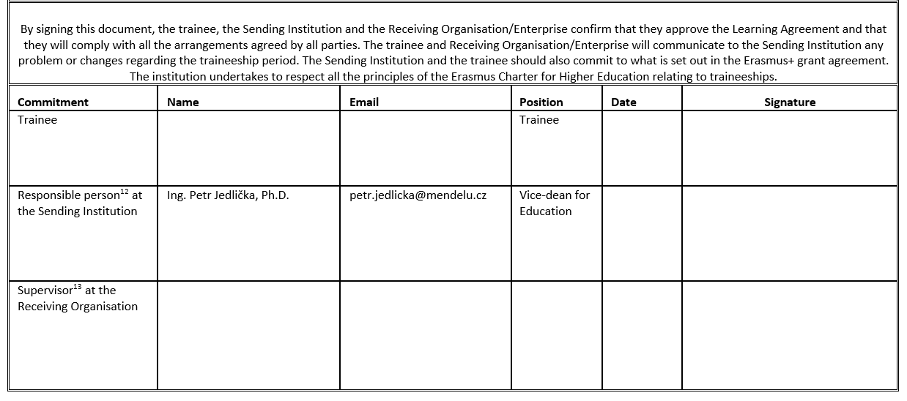
5
Send for check and get all required signatures
Fill out information about you and the supervisor at the receiving organization.
Traineeship Agreement process:
Send the completed form to anna.zavadilova@mendelu.cz or via MS Teams for checking.
Sign it in the office (Q1.90) or send it by post. For both options you will need information form the faculty coordinator.
After the vice-deans signature you will send it to the receiving institution.
You will send me back Traineeship agreement with all 3 signatures.

