Slide 1
Guide for the Learning agreement proposal

Slide 2
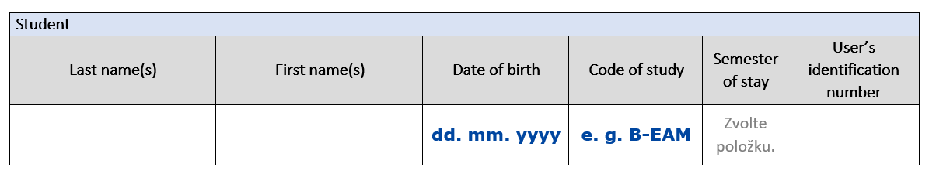
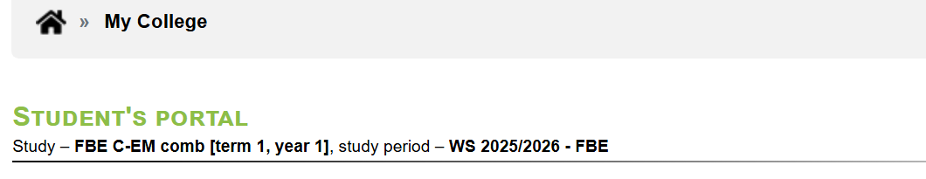

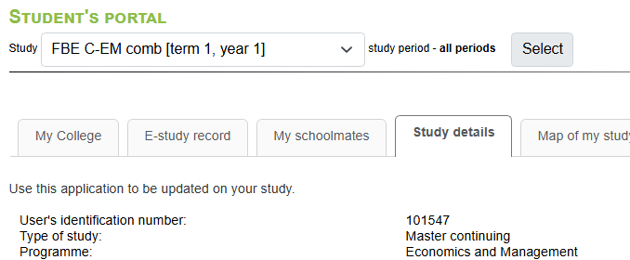
1
Fill out the information about yourself
You will find your code of study in your UIS → My College → Student’s portal
You will find your UIN in your
UIS → My College → Student’s portal → Study details

Slide 3
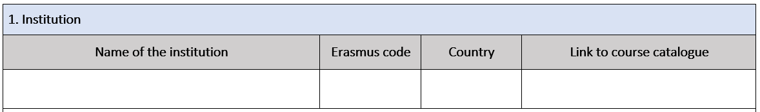
2
Fill out the information about your first chosen university
You will find the Erasmus code in the excel with all the available universities.
Copy link of their course catalogue. If you received one through email enter the university’s official website.

Slide 4
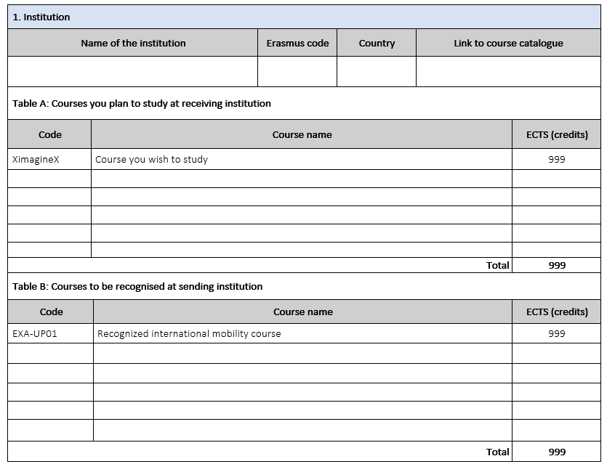
3
Enter what courses you would study there into table A
Find the course catalogue of your chosen institution (google name of the institution + „course catalogue“ and select courses you would like to study there.
Requirements:
The selected courses must be relevant to your field of study.
You cannot choose any course you have already completed at MENDELU.
Fill out table A:
For each course, provide the following details:
Course code (if available)
Course name
Number of credits
You must select courses totaling at least 18 credits.

Slide 5
4
Enter how these courses should be recognized into table B
If a course at the host institution is similar to a course in your MENDELU study plan, you may choose to have it recognized as that course. In this case, you will not need to complete the MENDELU course again.
If you cannot find a similar course in your study plan, you will select to have it recognized as EXA-UP0x Recognized International Mobility Course.
The total credits in both tables (host institution courses and recognized MENDELU courses) must be equal.
You can find your MENDELU study plan in your UIS → Student’s portal → Plan progress check
Even courses from your future specialization can be recognized

