Slide 1
Mendel
University
in Brno

Slide 2
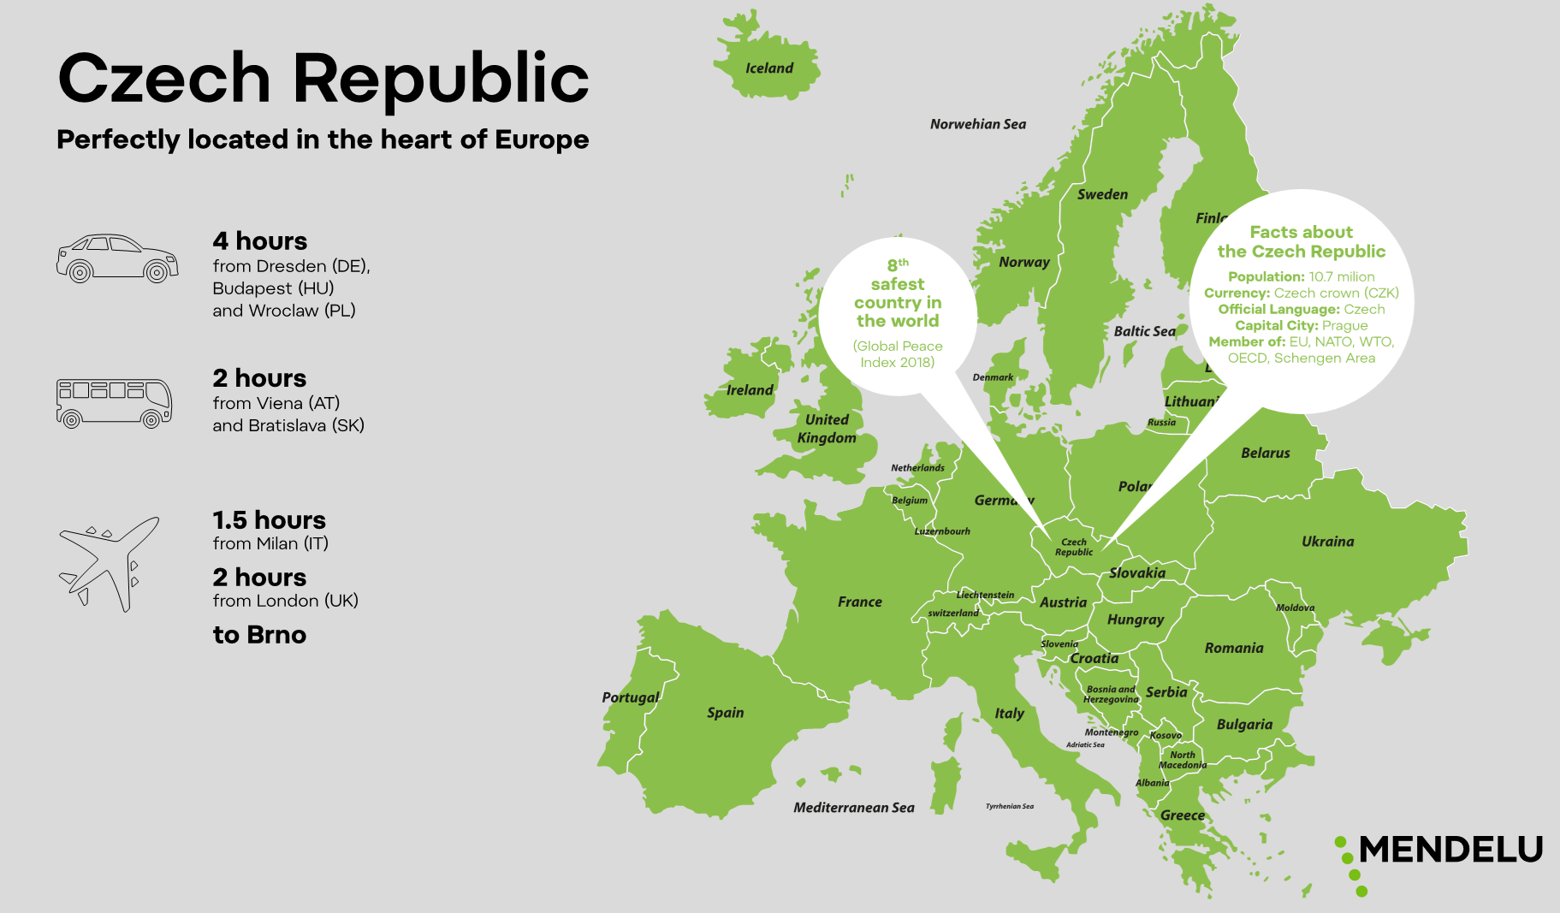
Czech Republic

Slide 3
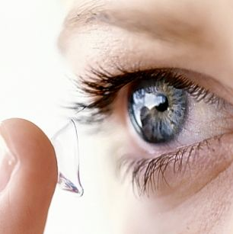
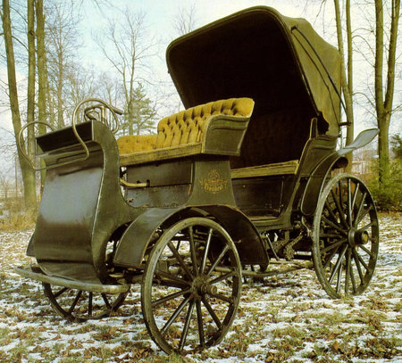
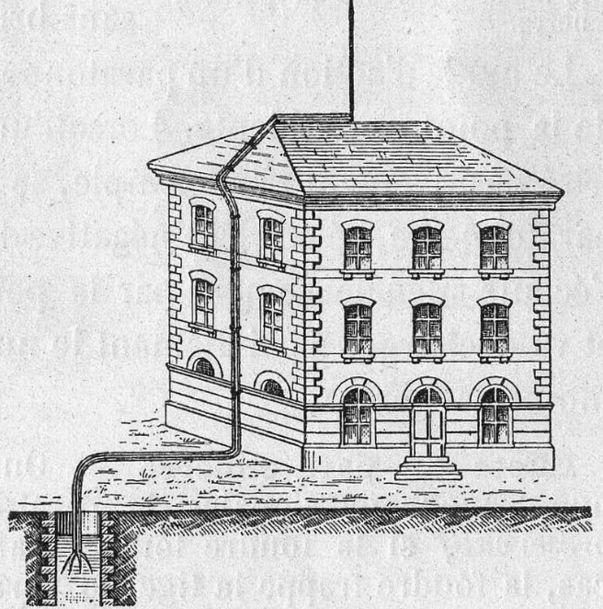
Czech inventions
1961 Contact gel lenses (Otto Wichterle)
1921 Robot (R.U.R., Karel Čapek)
1897 The first mass-produced car in Central Europe → Tatra Präsident
1843 Sugar cube (Jakub Kryštof Rad)
1754 Lightning conductor (Prokop Diviš)

Slide 4
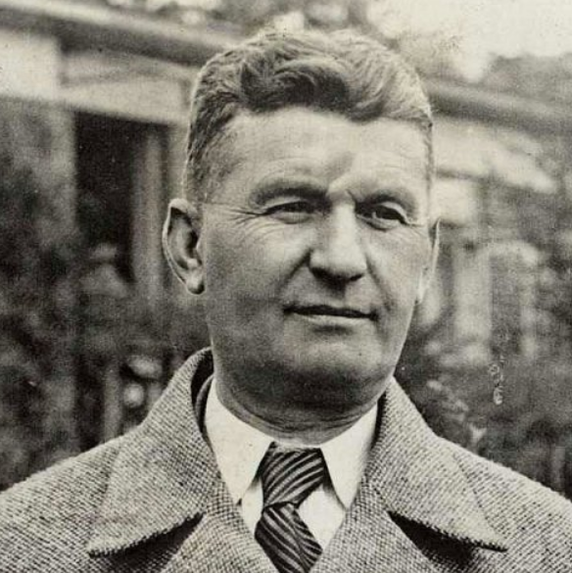
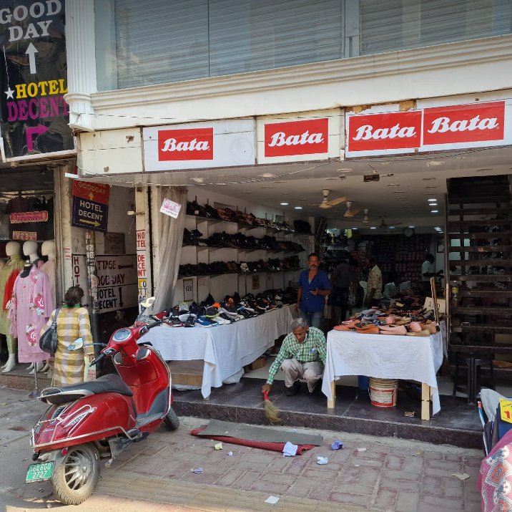
Czech innovator
Tomáš Baťa (1876–1932)
family shoe business since 1667
founder of the Bata Shoes company
one of the world's biggest multinational retailers
retailer of shoes and accessories

Slide 5
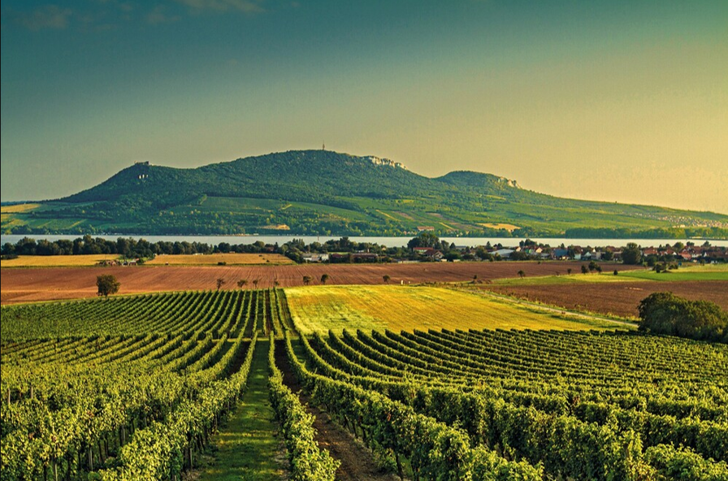
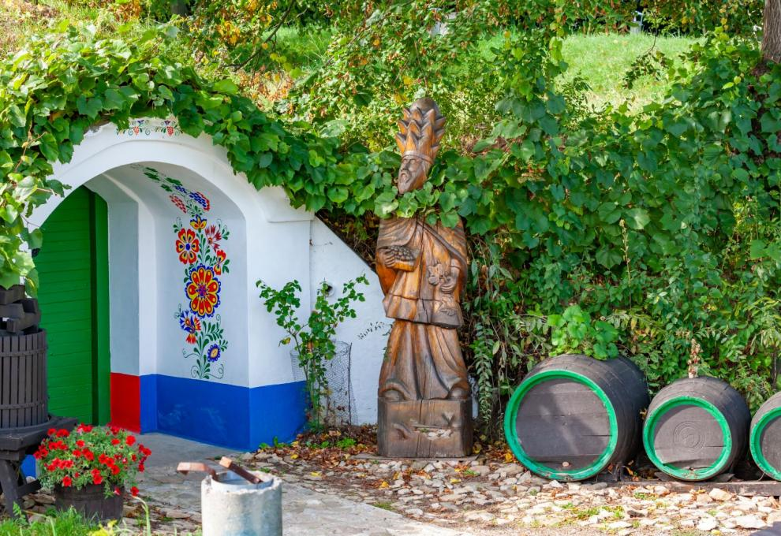
Southern Moravian region

Slide 6
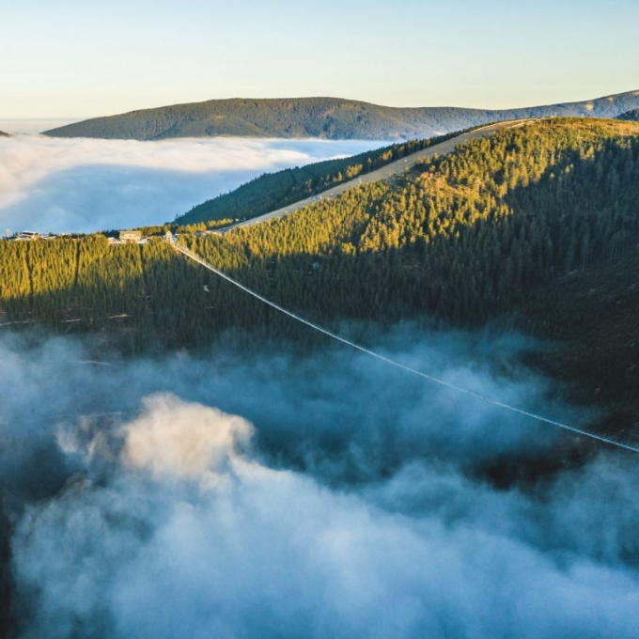
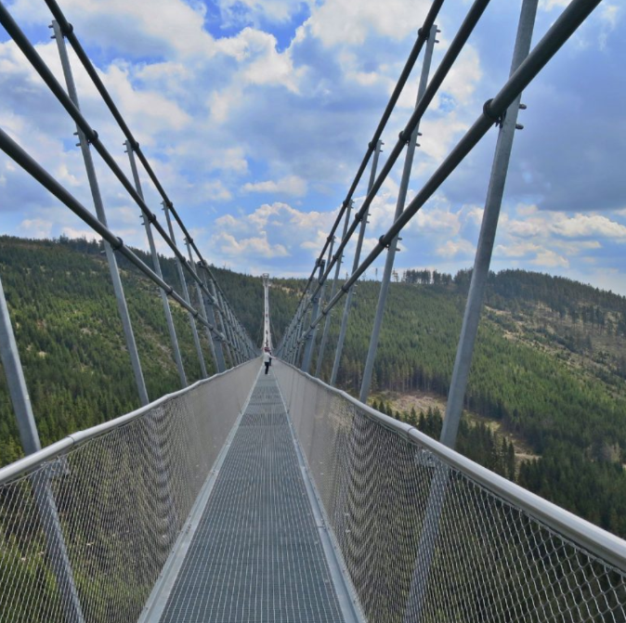
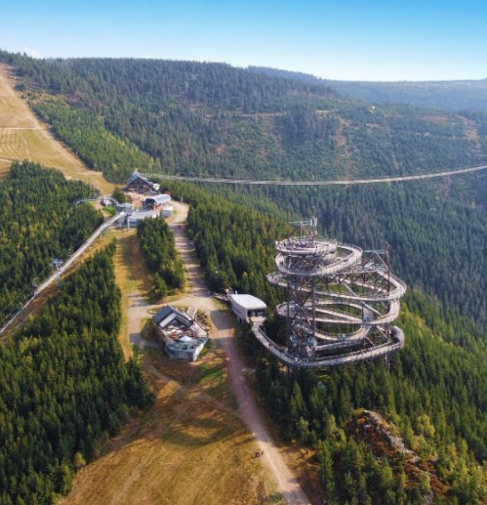
Moravian Region – the highest suspension bridge in the world
length 721 m
from 1110 to 1116 meters above sea level
up to 96 m above the ground
can withstand a wind speed of 200 km/h.

Slide 8
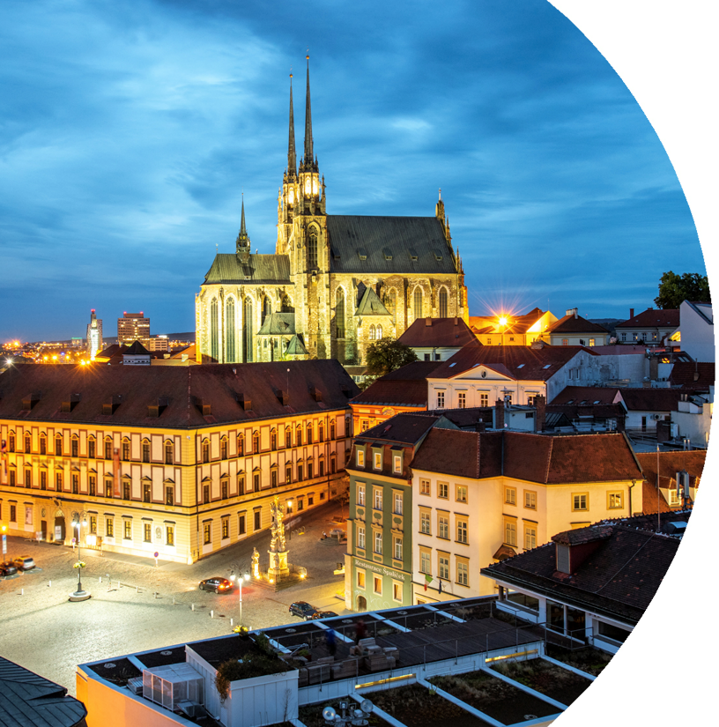
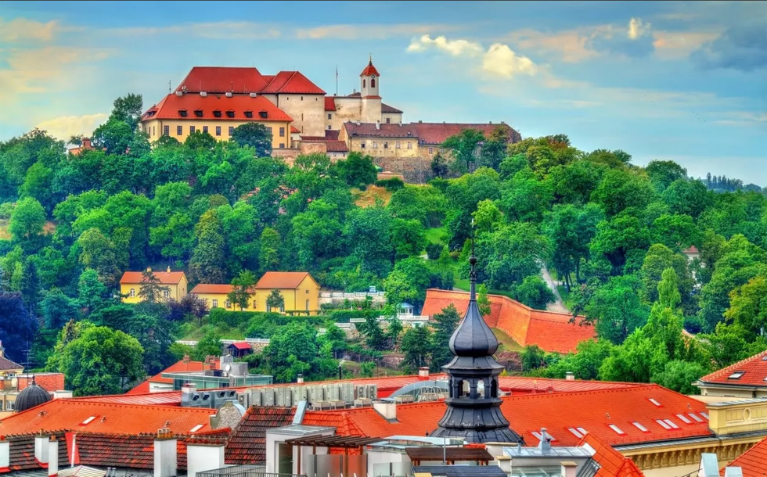
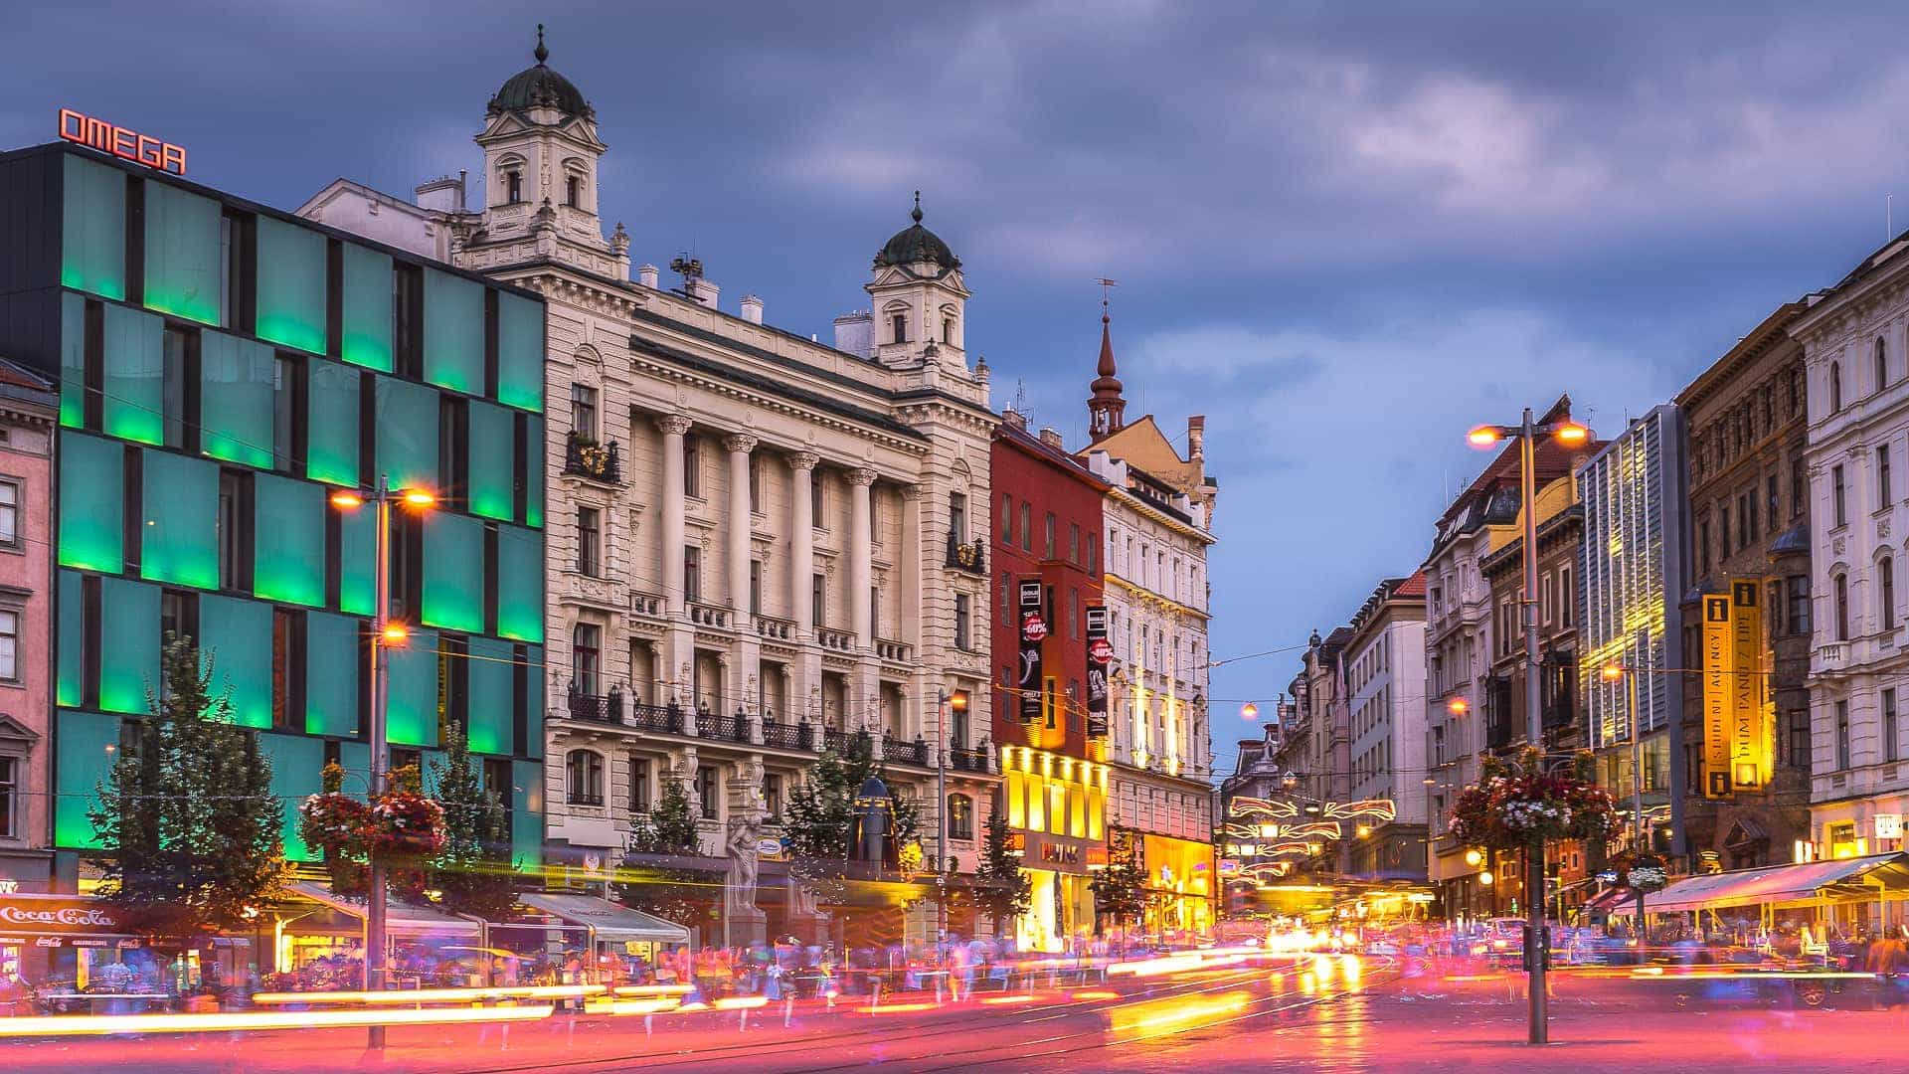
Brno
2nd largest in the Czech Republic
4th best student city in the world
400 000 inhabitants
Over 60 000 students
13 universities, Central European Institute of Technology (CEITEC)
Business Incubators
Hi-tech companies: Avast, Honeywell, Thermo-Fisher…
Moravian cuisine and drinks (wineries, breweries, …)

Slide 9
Czech Republic

Slide 10
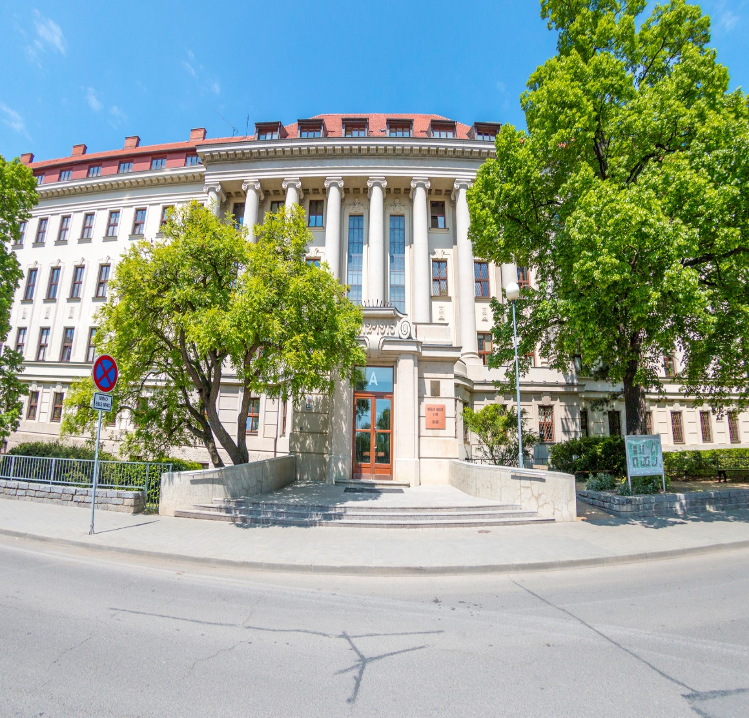
Mendel University in Brno
More than 100 years of tradition
5 faculties + Institute of Lifelong Learning
9000 students, 19% international
We link study with practice
It's not just about studying! We have many other benefits...

Slide 11
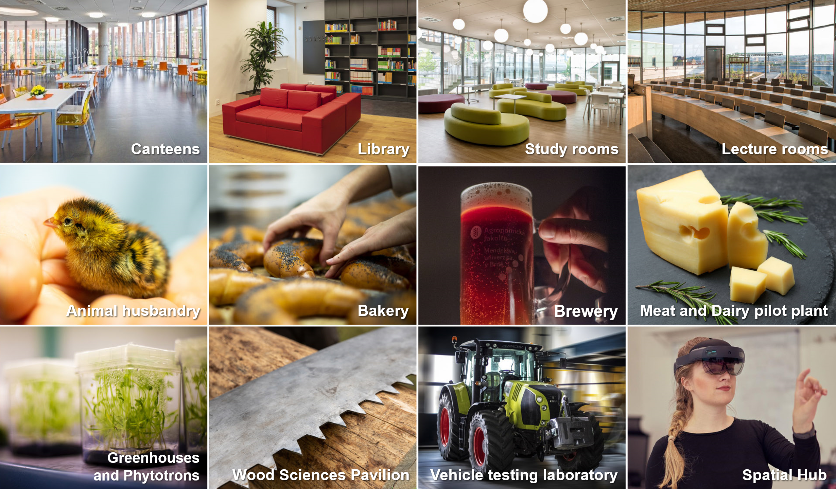

Slide 12
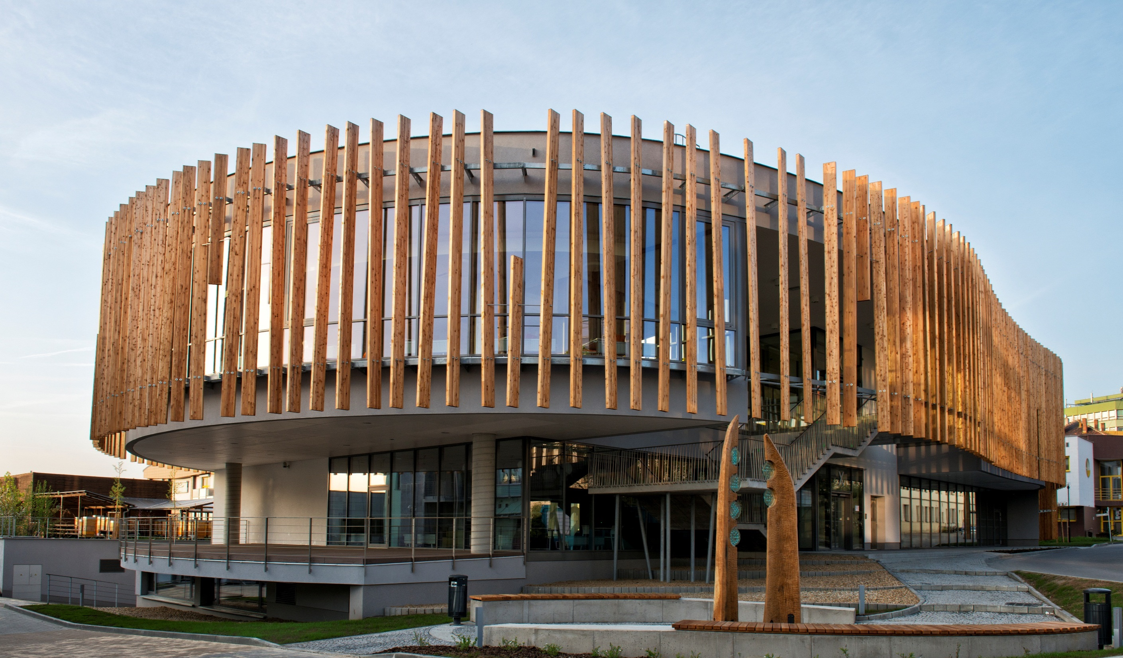
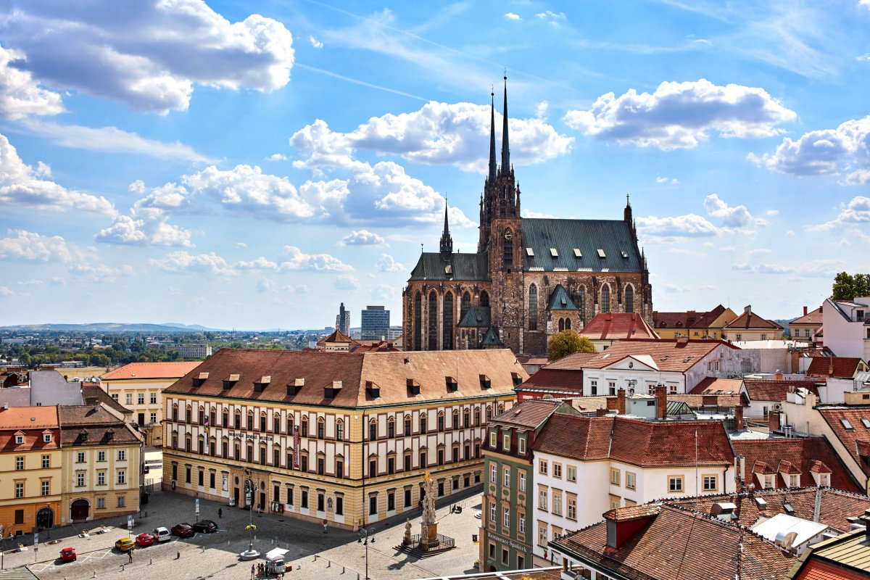
Cost of living in Brno
11 EUR for public transport per month
(student fare)
160 EUR for the cheapest accommodation
at MENDELU halls of residence (per month)
4 EUR per lunch meal

Slide 13
Food & Drinks
Several canteens and buffets
Large selection of dishes (incl. vegetarian)
Cafes and restaurants nearby
Many restaurants with international
cuisine in Brno

Slide 14
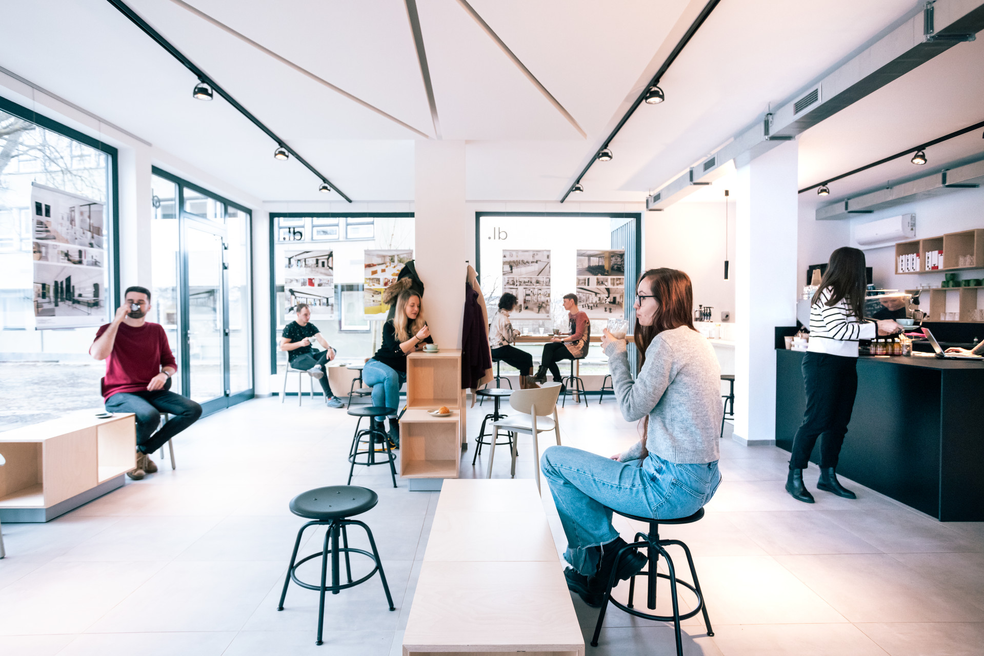
design lab MENDELU – Espresso bar

Slide 15
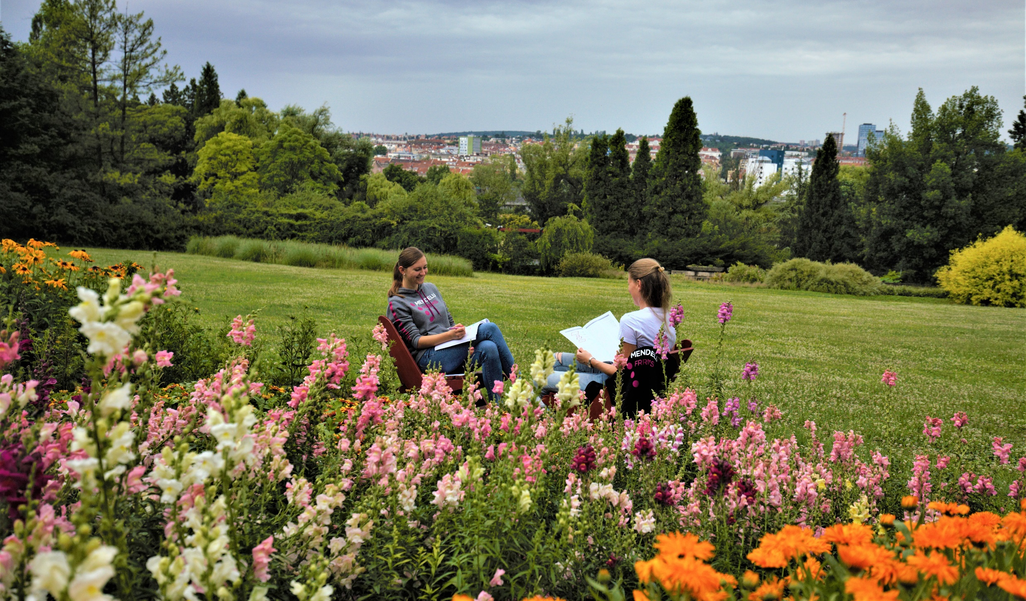
Arboretum

Slide 16
Sport activities at MENDELU
More than 30 sports activities for students
2 sports activities during the Bachelor study and 2 during the Master study are free of charge

Slide 17
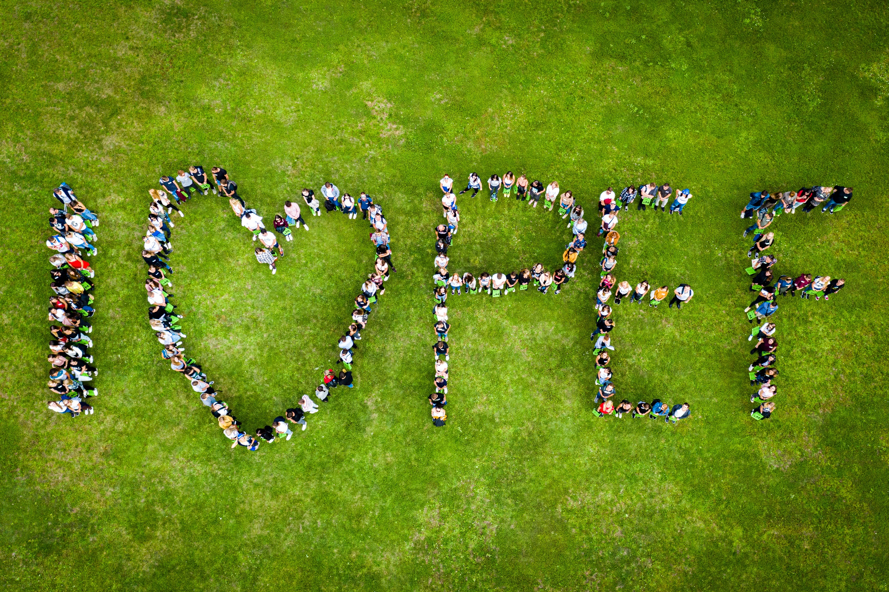
Faculty of Business
and Economics
65-years tradition (1959–2024)
Innovating study programmes
(Bachelor, Master, Ph.D.)
Specialized laboratories
Modern study rooms
Relaxation zones

Slide 18
Faculty of Business and Economics
Member of the European Council for Business Education
A modern building
Building of the year 2005
Computer labs (Laboratory of Network Technology; Virtual Reality Laboratory, Eye-tracking laboratory)
9 departments, 3000 students
bachelor, master and doctoral level

Slide 19
Study programmes taught in English
Economics and Management (Bc.)
Specialization in Management and marketing
Economics and Management (Ing.)
Specialization in Human Resources and International Leadership
Specialization in Management
Open informatics (Ing.)

Slide 20
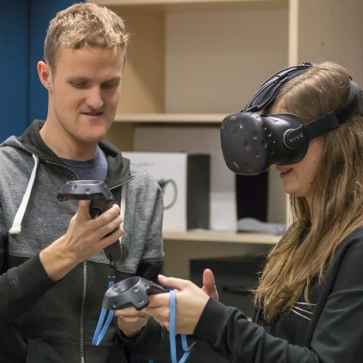
Research teams at FBE MENDELU
The research focus of the faculty can be grouped into 5 basic areas:
Bioeconomic modelling
The research team experienced with application of statistical methods and optimization techniques in various areas
SMART SOCIETY: Socioeconomic think-tank
The research team engaged in the research of 3 sub-areas – socio-economic, consumer behaviour and management choice.
Spatial Hub
Interdisciplinary team focused primarily on the analysis of people’s behaviour.
MENDEL FINHUB
Policy and uncertainty modelling including decision making processes employing Frequentist and Bayesian frameworks.

Slide 21
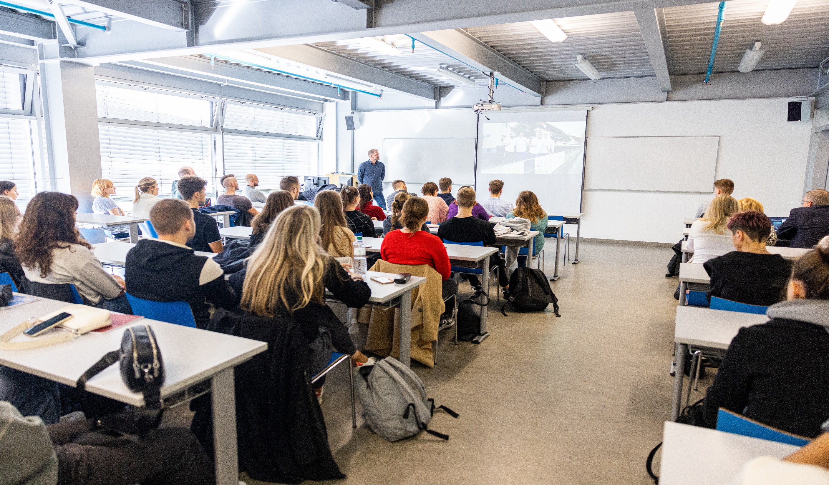
Study at FBE MENDELU
Expert lectures
Creating your own timetables - work while studying
Credits and exams (up to 3 retakes)
Possibility of repeating courses
Chillout zones

Slide 22
You can study abroad!
Erasmus+ and Bilateral Agreements
Improve your foreign language skills
Make new friends
Experience of a lifetime

Slide 23
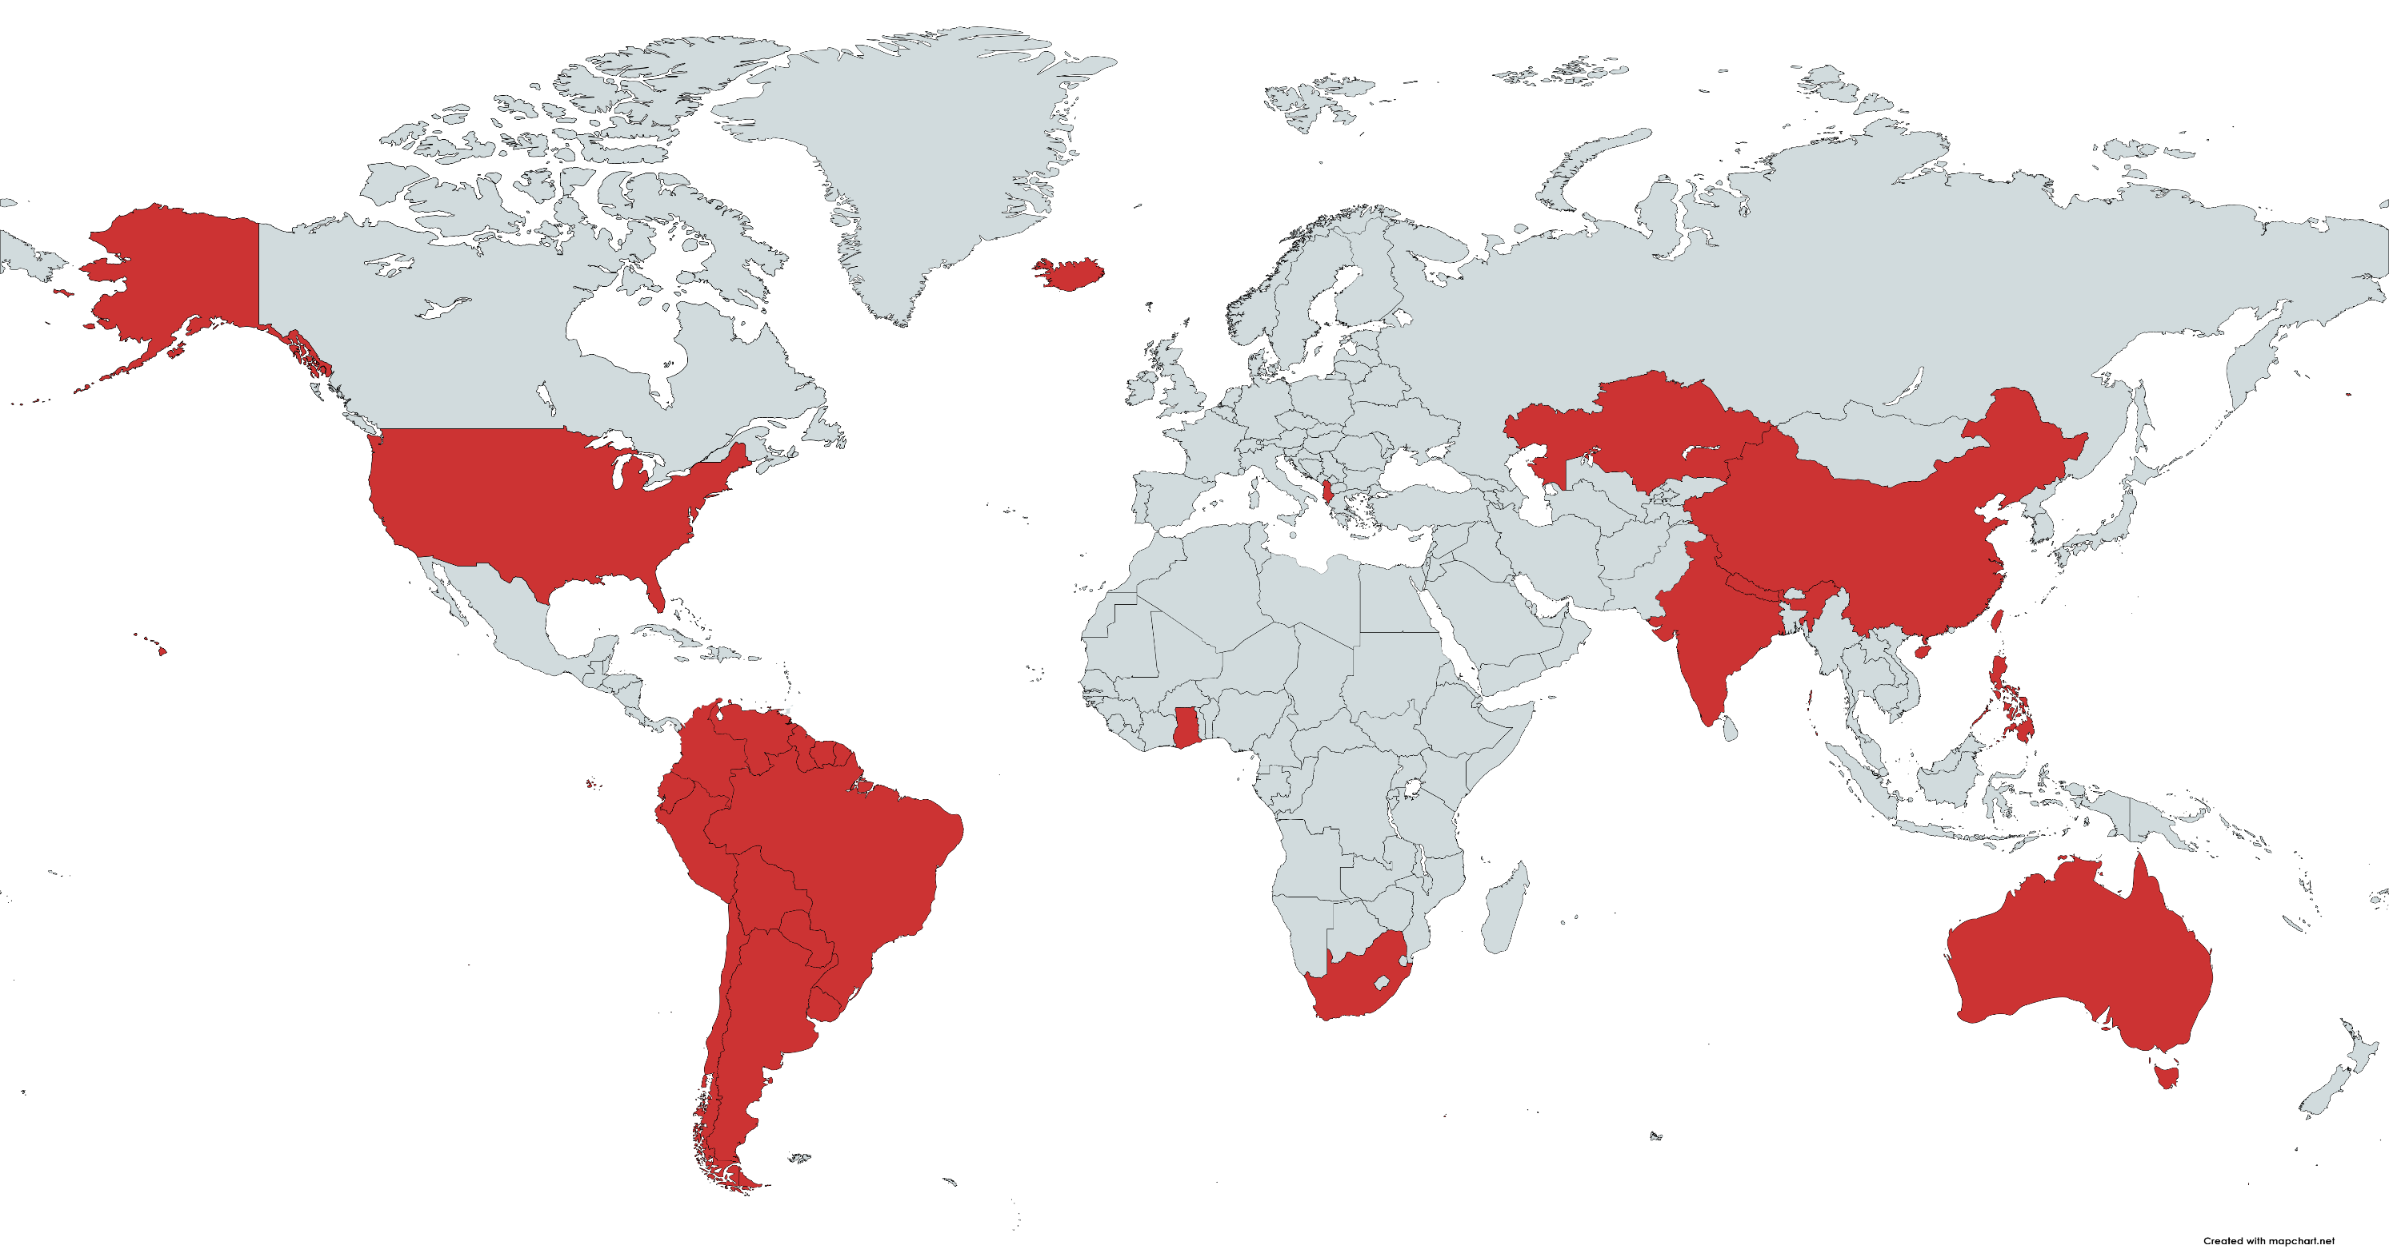
Bilateral Agreements
Study at FBE MENDELU
Notes:
University of Elbasan “Aleksander Xhuvani” - Albania
Kazguu University JSC - Kazakhstan
University of International Business - Kazakhstan
Dongguan University of Technology - China
Oregon State University - USA
University of Asia and the Pacific - Philippines

Slide 24
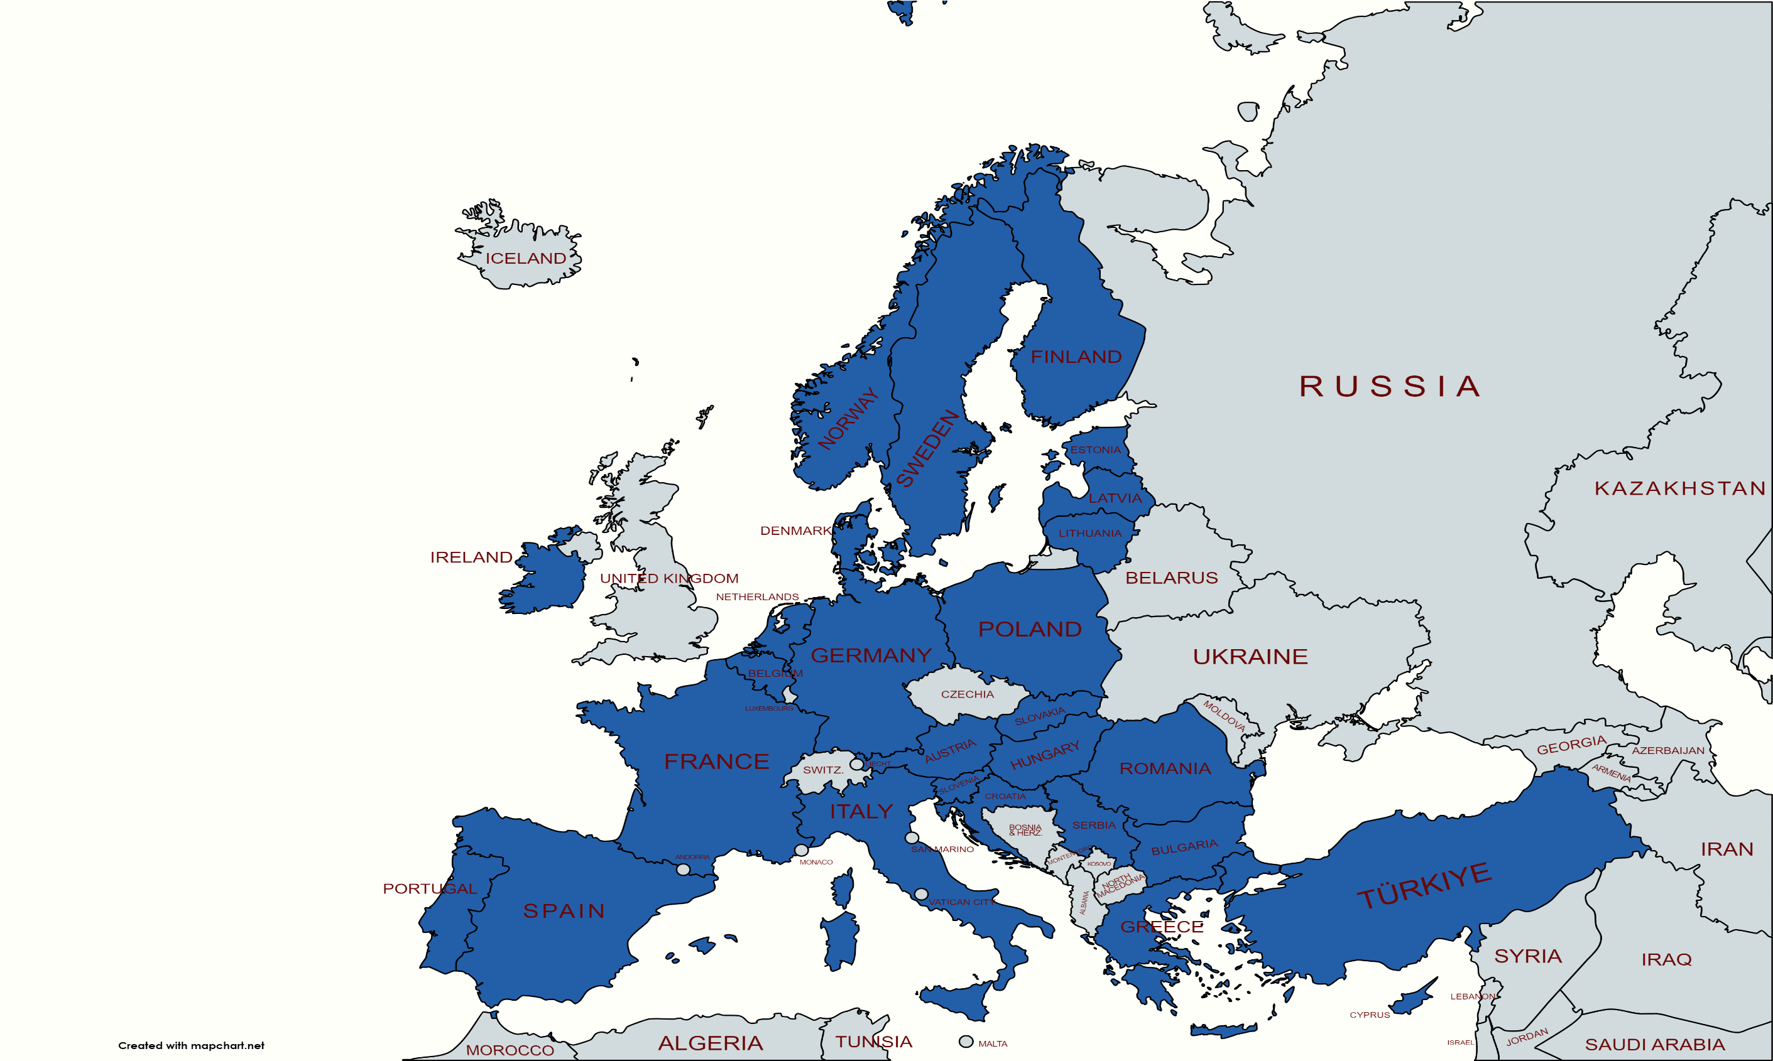
Available ERASMUS+ countries
Study at FBE MENDELU
Expert lectures
Creating your own timetables - work while studying
Credits and exams (up to 3 retakes)
Possibility of repeating courses
Chillout zones

Slide 25
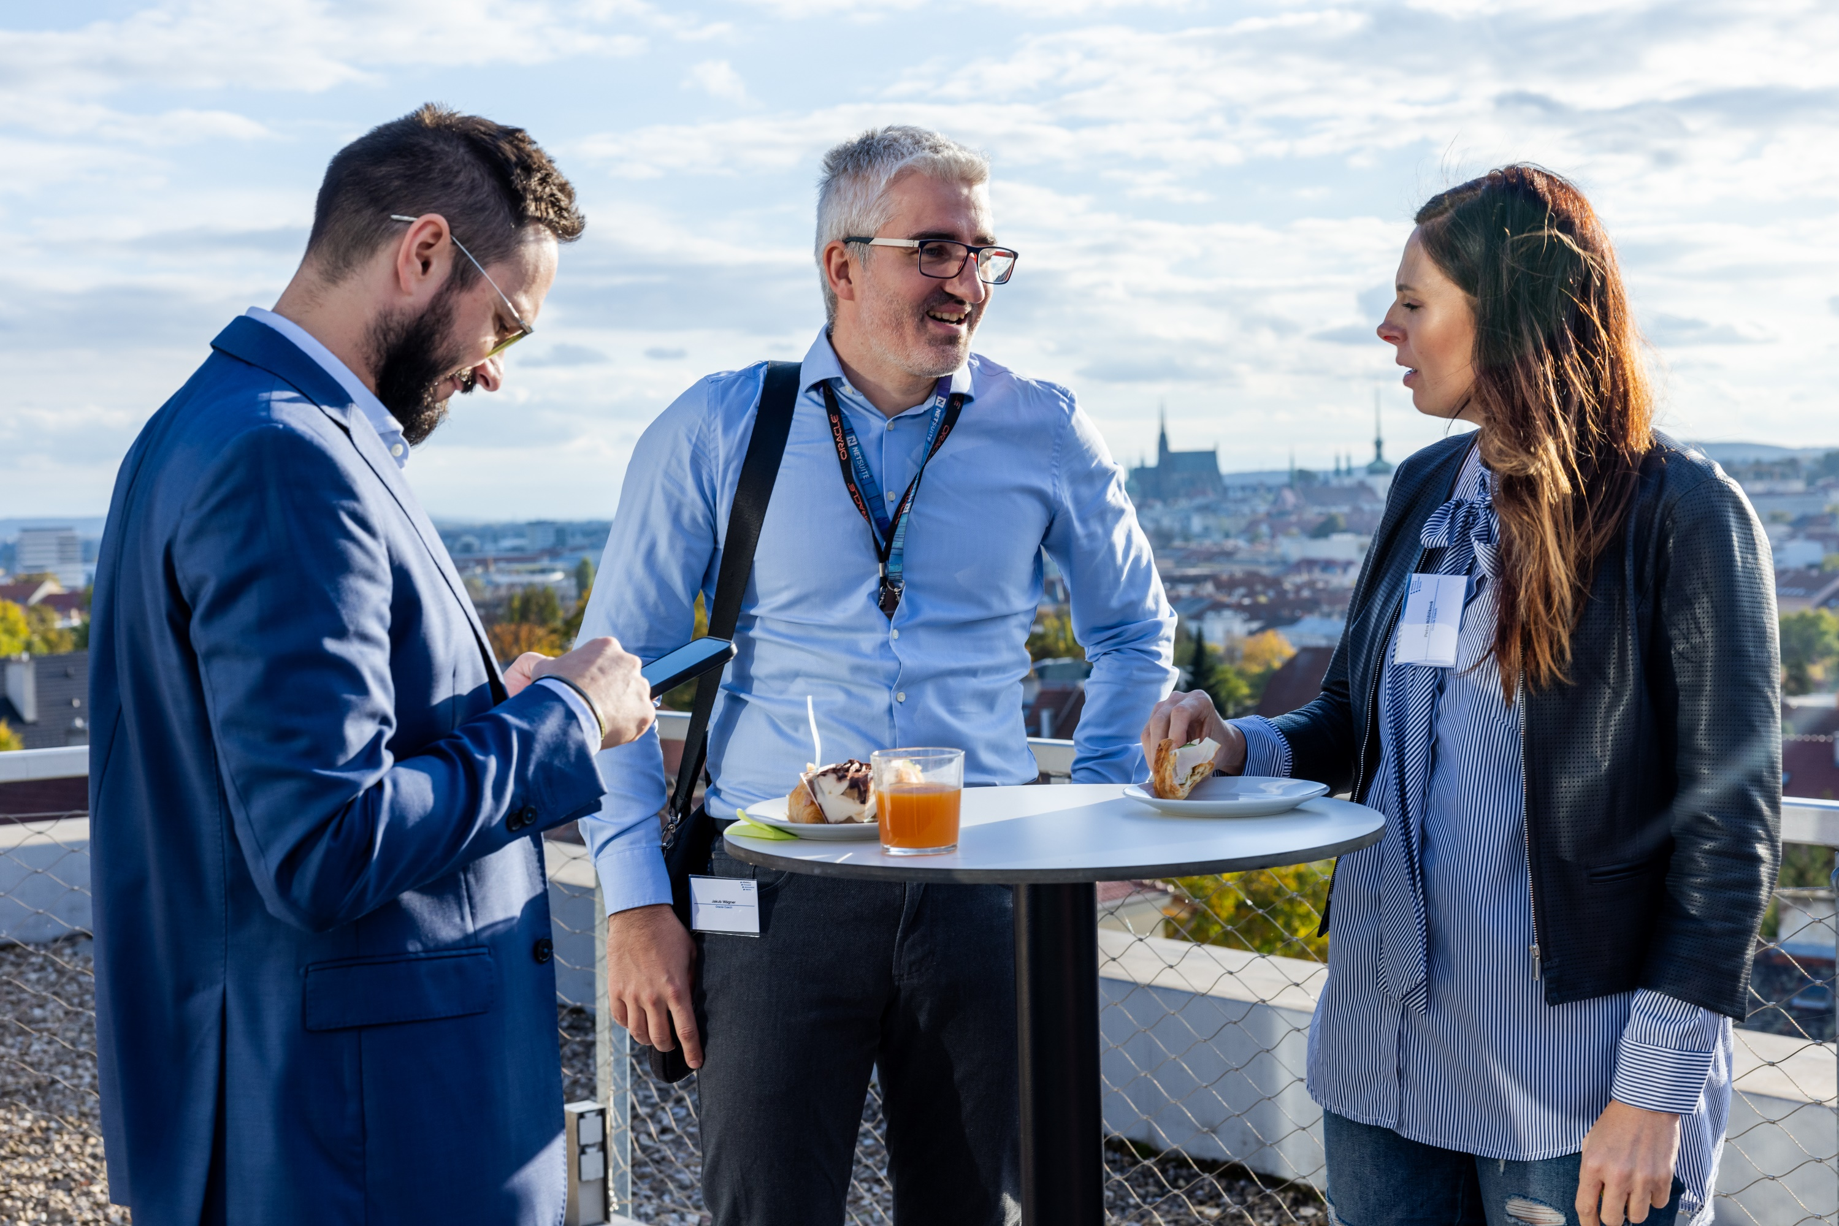
Partnership
Applied research and consultancy
Internship and job opportunities for students
Lectures and workshops at the faculty
Events and promotion
Infrastructure developement
Notes:
At Faculty of Business and Economics we cooperate with universities, secondary schools, research institutions and private companies in the Czech Republic and abroad. Long-term important partnerships inlcudes cooperation in teaching, thesis topics, science and research.

Slide 26
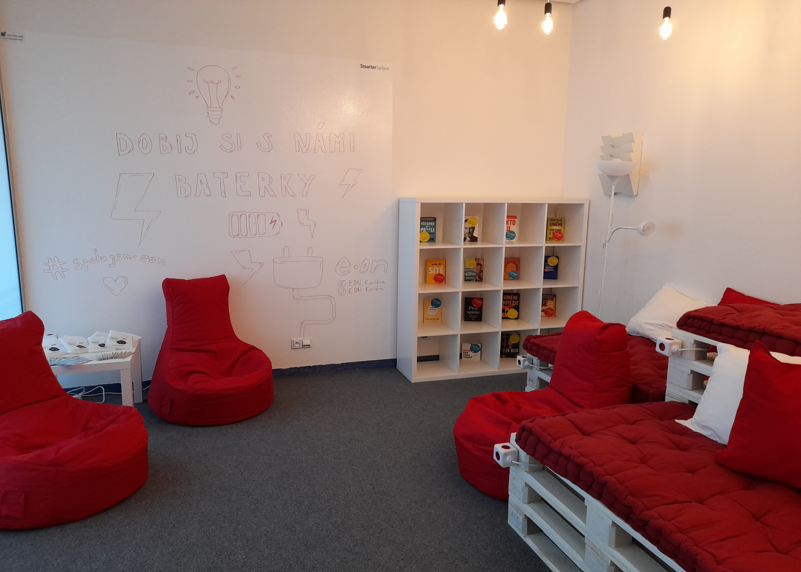
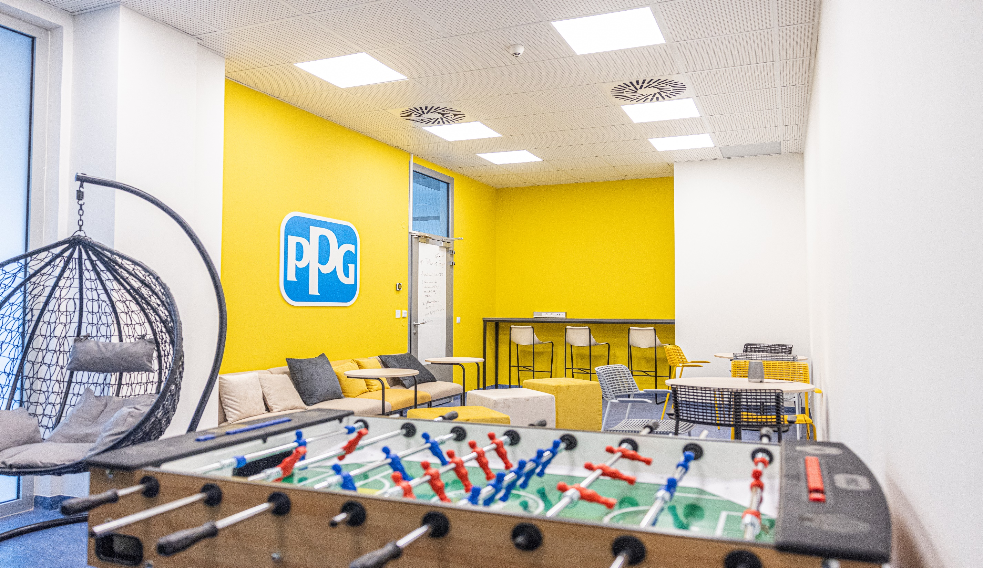

Slide 27
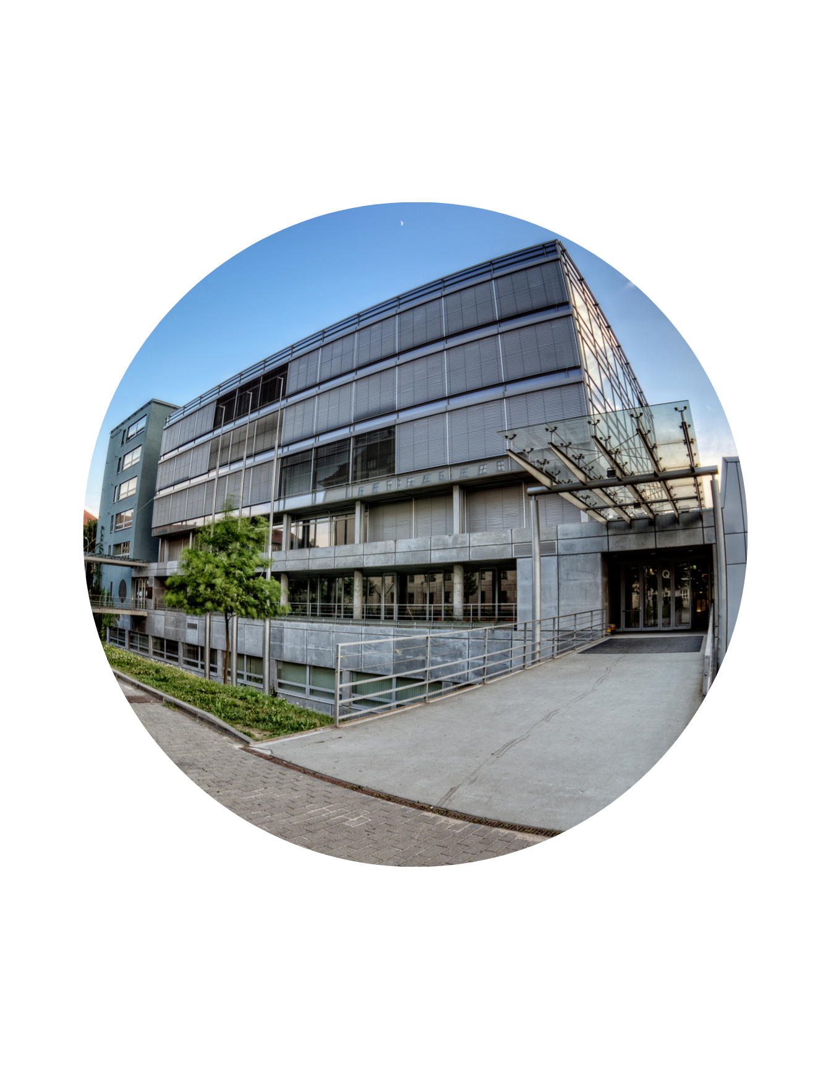
www.pef.mendelu.cz/en
pef.mendelu
pefmendelu
Faculty of Business and Economics (FBE)

Slide 28
Thank you for your attention!

